Slide 1
Algorithms
Topological Sorting

Slide 2
Definition: DAG
A Directed Acyclic Graph often abbreviated DAG
DAGs used in many applications to indicate precedence among events.
If DFS of a directed graph yields no back edges, then the graph contains no cycles
A
D
A
D
B
B
G
G
F
C
E
F
C
E
This graph has more than one cycle.
Can you find them all?
This graph has no cycles, so it is a DAG.

Slide 3
Definition: Topological Sort
A topological sort of a DAG G = (V, E) is a linear ordering of all its vertices such that if G contains an edge (u, v), then u appears before v in the ordering.
If the graph is cyclic, then no linear ordering is possible.
A topological sort of a graph can be viewed as an ordering of its vertices along a horizontal line so that all directed edges go from left to right.
Topological sorting is thus different from the usual kind of "sorting" .

Slide 4
Topological Sort
DAG indicates precedence among events:
events are graph vertices, edge from u to v means event u has precedence over event v
Real-world example:
getting dressed
course registration
tasks for eating meal

Slide 5
Precedence Example
Tasks that have to be done to eat breakfast:
get glass, pour juice, get bowl, pour cereal, pour milk, get spoon, eat.
Certain events must happen in a certain order (ex: get bowl before pouring milk)
For other events, it doesn't matter (ex: get bowl and get spoon)
Notes:
5

Slide 6
Precedence Example
get glass
get bowl
pour juice
pour cereal
get spoon
pour milk
eat breakfast
Order: glass, juice, bowl, cereal, milk, spoon, eat.
6
Notes:
6

Slide 7
Why Acyclic?
Why must directed graph be acyclic for the topological sort problem?
Otherwise, no way to order events linearly without violating a precedence constraint.
7
Notes:
7

Slide 8
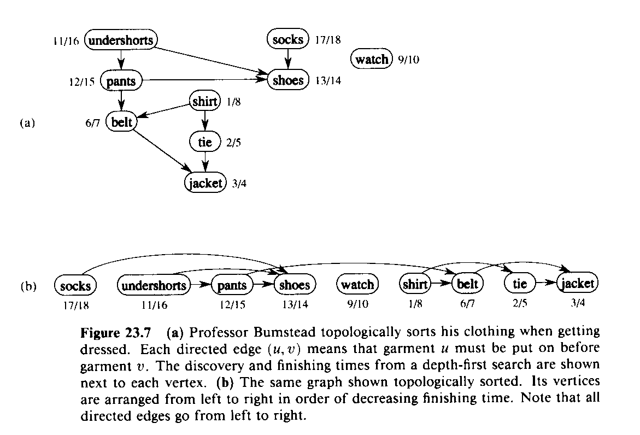
Topological Sort
for Directed, Acyclic Graph (DAG)
G=(V,E)
TOPOLOGICAL-SORT(G)
1 DFS(G) computes “finishing times” for each vertex
2 as each vertex is finished, insert it onto front of list
3 return list
Produces linear ordering of vertices.
For edge (u,v), u is ordered before v.

Slide 9
Topological Sort
The following algorithm topologically sorts a DAG:
TOPOLOGICAL-SORT(G)
call DFS(G) to compute finishing times f[v] for each vertex v
as each vertex is finished, insert it onto the front of a linked list
return the linked list of vertices
Note that all tree edges and non-tree edges point to the right

Slide 10
Topological Sort
We can perform a topological sort in time Θ(V + E), since depth-first search takes Θ(V + E) time and it takes O(1) time to insert each of the |V| vertices onto the front of the linked list.

Slide 11
Topological Sort: DFS
C
G
A
B
D
E
F
H

Slide 12
Topological Sort: DFS
C
dfs(A)
G
A
B
D
E
F
H

Slide 13
Topological Sort: DFS
C
dfs(A)
dfs(D)
G
A
B
D
E
F
H

Slide 14
Topological Sort: DFS
C
dfs(A)
dfs(D)
dfs(E)
G
A
B
D
E
F
H

Slide 15
Topological Sort: DFS
C
dfs(A)
dfs(D)
dfs(E)
dfs(F)
G
A
B
D
E
F
H

Slide 16
Topological Sort: DFS
C
dfs(A)
dfs(D)
dfs(E)
dfs(F)
dfs(H)
G
A
B
D
E
F
H

Slide 17
Topological Sort: DFS
C
dfs(A)
dfs(D)
dfs(E)
dfs(F)
G
A
B
D
E
F
H
7

Slide 18
Topological Sort: DFS
C
dfs(A)
dfs(D)
dfs(E)
G
A
B
D
E
F
6
H
7

Slide 19
Topological Sort: DFS
C
dfs(A)
dfs(D)
G
A
B
D
E
5
F
6
H
7

Slide 20
Topological Sort: DFS
C
dfs(A)
dfs(D)
G
A
B
D
E
5
F
6
H
7

Slide 21
Topological Sort: DFS
C
dfs(A)
G
A
B
D
E
4
5
F
6
H
7

Slide 22
Topological Sort: DFS
C
dfs(A)
G
A
B
D
E
4
5
F
6
H
7

Slide 23
Topological Sort: DFS
C
G
A
3
B
D
E
4
5
F
6
H
7

Slide 24
Topological Sort: DFS
C
dfs(B)
G
A
3
B
D
E
4
5
F
6
H
7

Slide 25
Topological Sort: DFS
C
dfs(B)
G
A
3
B
D
E
4
5
F
6
H
7

Slide 26
Topological Sort: DFS
C
G
A
3
B
2
D
E
4
5
F
6
H
7

Slide 27
Topological Sort: DFS
C
dfs(C)
G
A
3
B
2
D
E
4
5
F
6
H
7

Slide 28
Topological Sort: DFS
C
dfs(C)
G
A
3
B
2
D
E
4
5
F
6
H
7

Slide 29
Topological Sort: DFS
C
dfs(C)
G
A
3
B
2
D
E
4
5
F
6
H
7

Slide 30
Topological Sort: DFS
C
dfs(C)
G
A
3
B
2
D
E
4
5
F
6
H
7

Slide 31
Topological Sort: DFS
C
dfs(C)
dfs(G)
G
A
3
B
2
D
E
4
5
F
6
H
7

Slide 32
Topological Sort: DFS
C
dfs(C)
G
1
A
3
B
2
D
E
4
5
F
6
H
7

Slide 33
Topological Sort: DFS
0
C
G
1
A
3
B
2
D
E
4
5
F
6
H
7

Slide 34
Topological Sort: DFS
0
C
G
1
A
3
B
2
D
E
4
5
F
6
H
7
Topological order: C G B A D E F H

